Slide 1


Credit Card Churn Prediction Model submitted: 2021-05-25

Slide 2
Objective
Explore and visualize the dataset.
Build a classification model to predict if the customer is going to churn or not
Optimize the model using appropriate techniques
4. Generate a set of insights and recommendations that will help the bank

Slide 3

Background
The Thera bank recently saw a steep decline in the number of users of their credit card, credit cards are a good source of income for banks because of different kinds of fees charged by the banks like annual fees, balance transfer fees, and cash advance fees, late payment fees, foreign transaction fees, and others. Some fees are charged on every user irrespective of usage, while others are charged under specified circumstances.
Customers’ leaving credit cards services would lead bank to loss, so the bank wants to analyze the data of customers’ and identify the customers who will leave their credit card services and reason for same – so that bank could improve upon those areas
You as a Data scientist at Thera bank need to come up with a classification model that will help bank improve their services so that customers do not renounce their credit cards

Slide 4
Features: Customer Details
Data DictionaryCLIENTNUM: Client number. Unique identifier for the customer holding the account
Attrition_Flag: Internal event (customer activity) variable - if the account is closed then 1 else 0 [PREDICTOR VARIABLE]
Customer_Age: Age in Years
Gender: Gender of the account holder
Dependent_count: Number of dependents
Education_Level: Educational Qualification of the account holder
Marital_Status: Marital Status of the account holder
Income_Category: Annual Income Category of the account holder
Card_Category: Type of Card
Months_on_book: Period of relationship with the bank
Total_Relationship_Count: Total no. of products held by the customer
Months_Inactive_12_mon: No. of months inactive in the last 12 months
Contacts_Count_12_mon: No. of Contacts in the last 12 months
Credit_Limit: Credit Limit on the Credit Card
Total_Revolving_Bal: Total Revolving Balance on the Credit Card
Avg_Open_To_Buy: Open to Buy Credit Line (Average of last 12 months)
Total_Amt_Chng_Q4_Q1: Change in Transaction Amount (Q4 over Q1)
Total_Trans_Amt: Total Transaction Amount (Last 12 months)
Total_Trans_Ct: Total Transaction Count (Last 12 months)
Total_Ct_Chng_Q4_Q1: Change in Transaction Count (Q4 over Q1)
Avg_Utilization_Ratio: Average Card Utilization Ratio

Slide 5

Focal Areas to Avoid Attrition

Slide 6
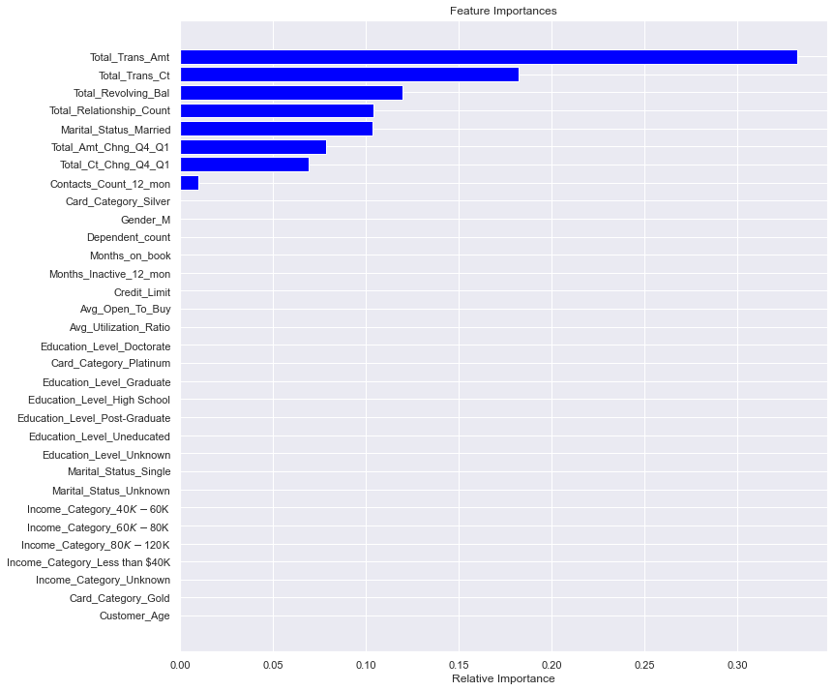
Feature Importance

Slide 7
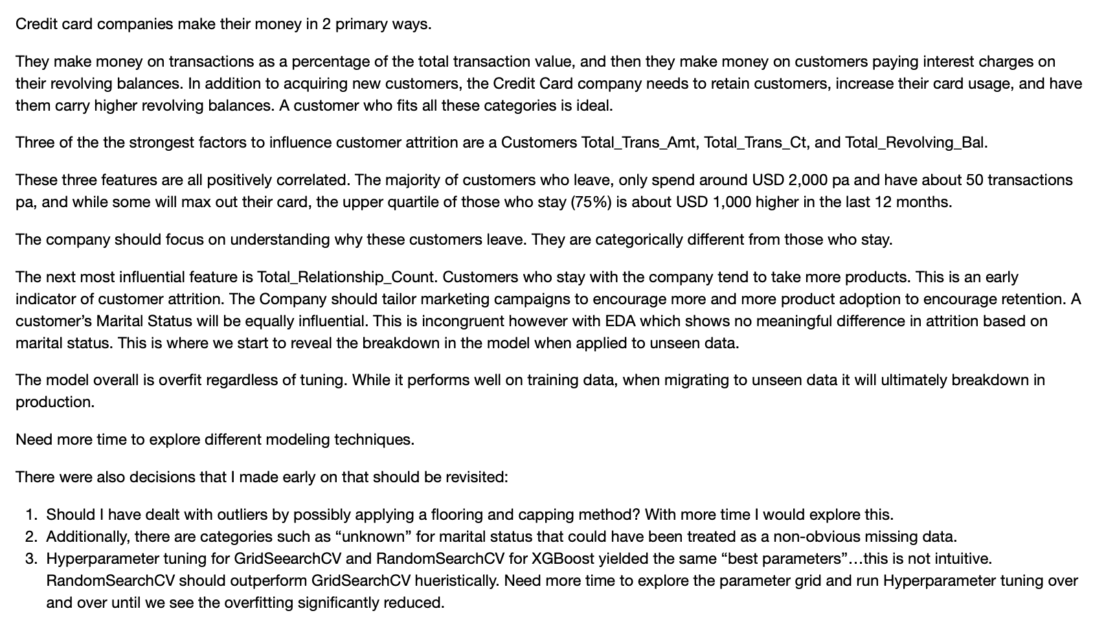
Business
Insights

Slide 8
Credit Card Churn Prediction Model submitted: 2021-05-25

